Slide 1
Uncertainties in Biomedical Instrumentation and Signal Processing
Miodrag Bolic
Associate Professor
School of Electrical Engineering and Computer Science (EECS)
Faculty of Engineering

Slide 2
Outline
Motivation: pervasive healthcare
Introduction
Uncertainty framework, types of uncertainty
Some mathematical methods for uncertainty evaluation
Confidence intervals
Resampling: Bootstrap and Monte Carlo
Uncertainty framework
Uncertainty propagation
Sensitivity analysis
Conclusion

Slide 3
Motivation: Unresolved uncertainty questions
How accurate are the resulting predictions?
Are the mathematical and physical models correct?
In general, how can we establish ”error bars” on the results?
How can we use the knowledge of uncertainties during calibration for prediction?
In systems with multiple processing steps, how does the uncertainty propagate?
Notes:
From Introduction to uncertainty representation and propagation, Gianluca Laccarino
AVT--‐193 Short Course on Uncertainty Quantification

Slide 4
Modeling Approach
Advantages
Concise summary of present knowledge of operation of a particular system
Predict outcomes of modes of operation not easily studied experimentally
Clarify or simplify complex experimental data
Suggest new experiments to advance understanding of a system
Limitations
Models often require many simplifying assumptions
beware of garbage in, garbage out
Validation of model predictions is essential

Slide 5
Types of uncertainty
An error δ = measured value– “true” value of density
An uncertainty u is an estimate of an interval ±u that should contain an error.
GUM categorization :
Type A: “method of evaluation of uncertainty by the statistical analysis of series of observations”
Type B: “method of evaluation of uncertainty by means other than the statistical analysis of series of observations”

Slide 6
Observing nature and predicting events
Observations: we are unable to observe and/or predict nature accurately
the limited accuracy of measurement instruments,
the exceedingly high cost of performing accurate experiments and/or measurements,
the lack of accurate models or the computational need of using simplified ones.
Predictions: the result of a combination of measurements, modeling and simulations
Models are based on certain levels of approximation, introduced to make them manageable

Slide 7
Uncertainty quantification
Uncertainty Quantification (UQ) aims at developing rigorous methods to characterize the impact of ”limited knowledge” on quantities of interest.
Statistics of an outcome of interest, such as its expectation and the variance, commonly requires the evaluation of integrals
It is usually summarized through confidence intervals
UQ is commonly based on three fundamental activities
Characterization of the sources of uncertainty;
Propagations of the uncertainties in the input data/model through the model itself;
Analysis of the model outputs.
Notes:
Limited knowledge – can be resuced by repeated experiments – epistemic
Aliatory uncertainty is natural variability and cannot be reduced – for example if we have wind velocity as an input to the model it changes over time
Regarding the characterization of uncertainties both direct and inverse methods are at disposal. Among the direct methods, the experimental observations, theoretical arguments and also expert opinions are the principal; inference and calibration are, instead, the fundamental techniques to translate observed data in statistical input parameters. The propagation process is the ensemble of operations which allows to obtain the uncertain outputs prescribing, to the uncertain model, the uncertain inputs. In this work the focus is totally devoted to aleatory, i.e. stochastic uncertainties, so in this case the probability framework plays a special role not only for the characterization of the sources of uncertainties, but also for their propagation. The final UQ step involves the analysis of the ensemble of output quantities of interest in term of probability distributions, cumulative distributions or other statistic characterization of data. Moreover, also sensitivity analysis (SA) of the data could be of interest. In the Part II of this thesis examples, of how the SA analysis can be employed to improve the understanding of complex system, will be provided. However, even if they are related, it is important to underline the difference between UQ and SA. Sensitivity analysis investigates the connection between inputs and outputs of a model and, in particular, it makes possible to relate the variability of the outputs to the variability of the inputs. SA does not need input data and can be conducted on purely mathematical analysis, while the UQ, given a system, aims to quantify its output uncertainty. The meaning of SA in the design context appears clear: large variations of some (identified) parameters generate large variations of the outputs. In the UQ context, however, a large sensitivity of a parameter is not strictly connected to large
uncertainties. In fact uncertainties related to input parameters, to which the system is greatly sensitive, could be so small to induce no uncertainty on the outputs at all. Moreover, it could be important determining how the uncertain structure of all the inputs maps the uncertain structure of all the outputs. In this case the SA is named global SA and its importance becomes crucial in the light of improving the quality of the model itself identifying the sources of a lack of knowledge. For instance, in the case of complex coupled physics phenomena, a global SA can indicate the relevant physical experiments to conduct to most reduce the epistemic uncertaint
From https://tel.archives-ouvertes.fr/tel-00954413/file/GERACI_GIANLUCA_2013_RED.pdf

Slide 8
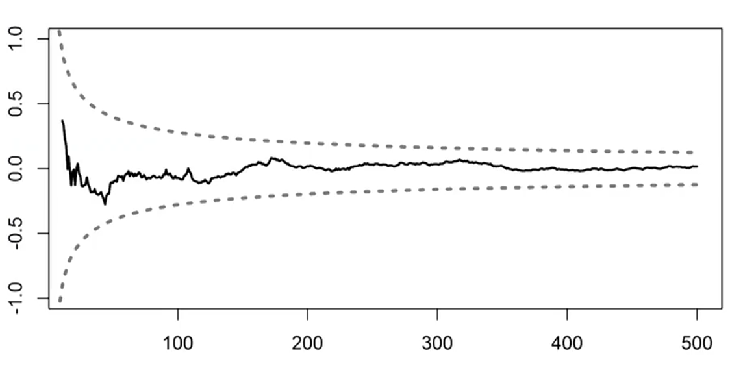
Examples of presenting uncertainty
Confidence levels
Heart rate is (60 ± 4) beats/minute (mean ± standard error)
Confidence levels
95% confidence for the heart rate is [52,68] beats/minute
Probability distributions
Determining different moments or quantiles
Prediction levels over time
Notes:
Intro to uncertainty quantification: https://nanohub.org/resources/10694

Slide 9
Some example from biomedical systems
Non-invasive brain stimulation
Finite element model
Modeling head and electrodes placed on the head
Analysis of sensitivity of the current on the types, thickness, placement and parameters of the electrodes
Blood pressure monitoring system
Model of cuff, tissues and arterial blood flow
Sensitivity analysis to determine the most important parameters
Providing confidence intervals in the estimation
Breathing rate estimation using radars
Modeling radar reflections from the body
Providing confidence intervals over time

Slide 10
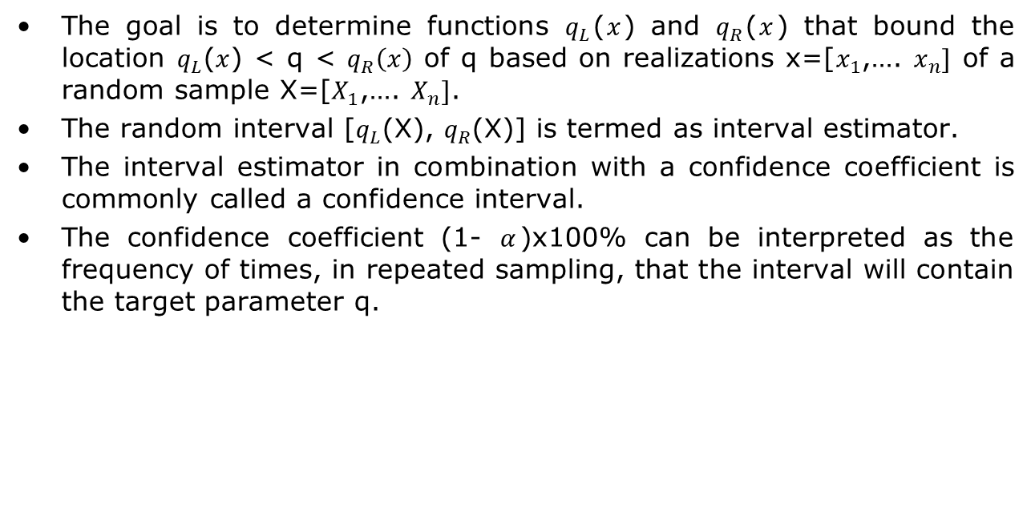
Confidence interval
The goal is to determine functions $q_{L}$($x$) and $q_{R}$($x$) that bound the location $q_{L}$($x$) < q < $q_{R}\left(x\right)$ of q based on realizations x=[$x_{1}$,…. $x_{n}]$ of a random sample X=[$X_{1}$,…. $X_{n}]$.
The random interval [$q_{L}$(X), $q_{R}$(X)] is termed as interval estimator.
The interval estimator in combination with a confidence coefficient is commonly called a confidence interval.
The confidence coefficient (1- $α$)x100% can be interpreted as the frequency of times, in repeated sampling, that the interval will contain the target parameter q.
Notes:
Ralph C. Smith, “Uncertainty Quantization, Theory, Problems and Applications,” SIAM, 2014.

Slide 11
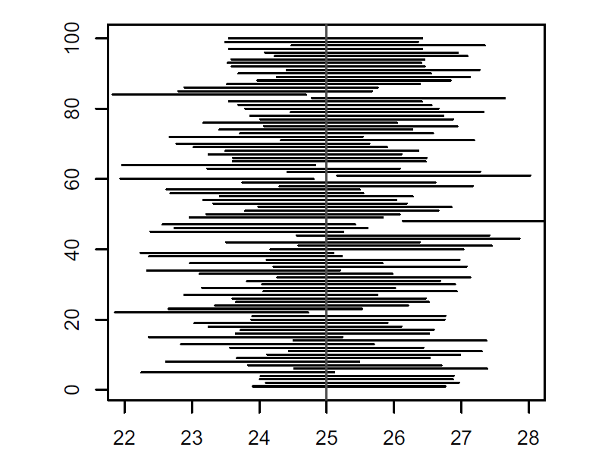
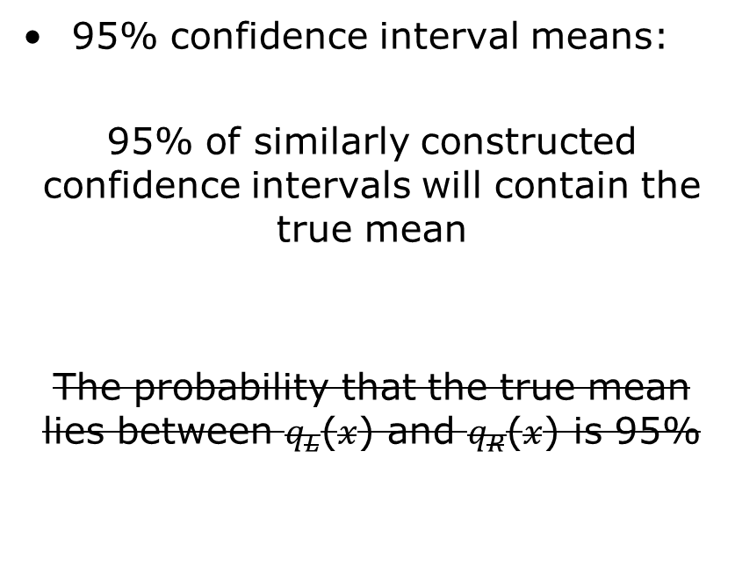
Confidence intervals interpretation
95% confidence interval means:
95% of similarly constructed confidence intervals will contain the true mean
The probability that the true mean lies between $q_{L}$($x$) and $q_{R}$($x$) is 95%

Slide 12
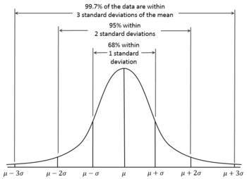

Confidence interval for the mean of Normal distribution with σ unknown
Suppose that X=(x₁,…,x_{n}) are samples from Normal distribution $X_{i}$ ~ N(µ, ${σ }^{2}$).
Empirical mean $\overline{x}=\sum_{i=1}^{n}{x_{i}}$ and
To determine information about the unknown mean, we consider the sample mean $\overline{x}$. 95% of the area of a normal distribution lies within two standard deviations of the mean

Slide 13
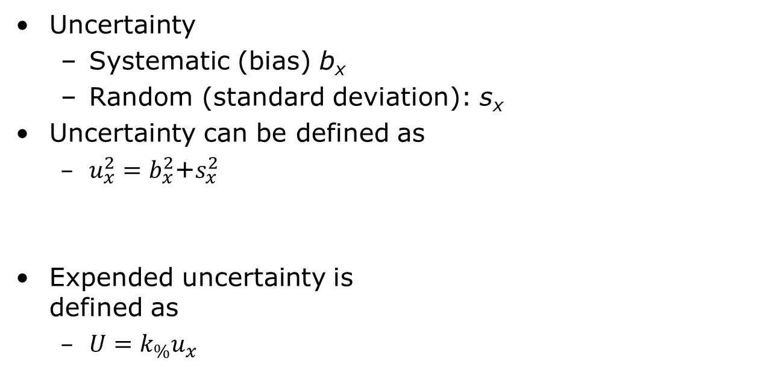
Expended Uncertainty
Uncertainty
Systematic (bias) b_{x}
Random (standard deviation): s_{x}
Uncertainty can be defined as
$u_{x}^{2}=b_{x}^{2}$+$s_{x}^{2}$
Expended uncertainty is defined as
$U=k_{\%}u_{x}$

Slide 14
Definitions
Standard uncertainty
uncertainty of the result of a single type of measurement includes Type A and/or Type B uncertainties
Expanded uncertainty
the standard uncertainty multiplied by a coverage factor
Standard error SE
Standard deviation of the sample statistics

Slide 15
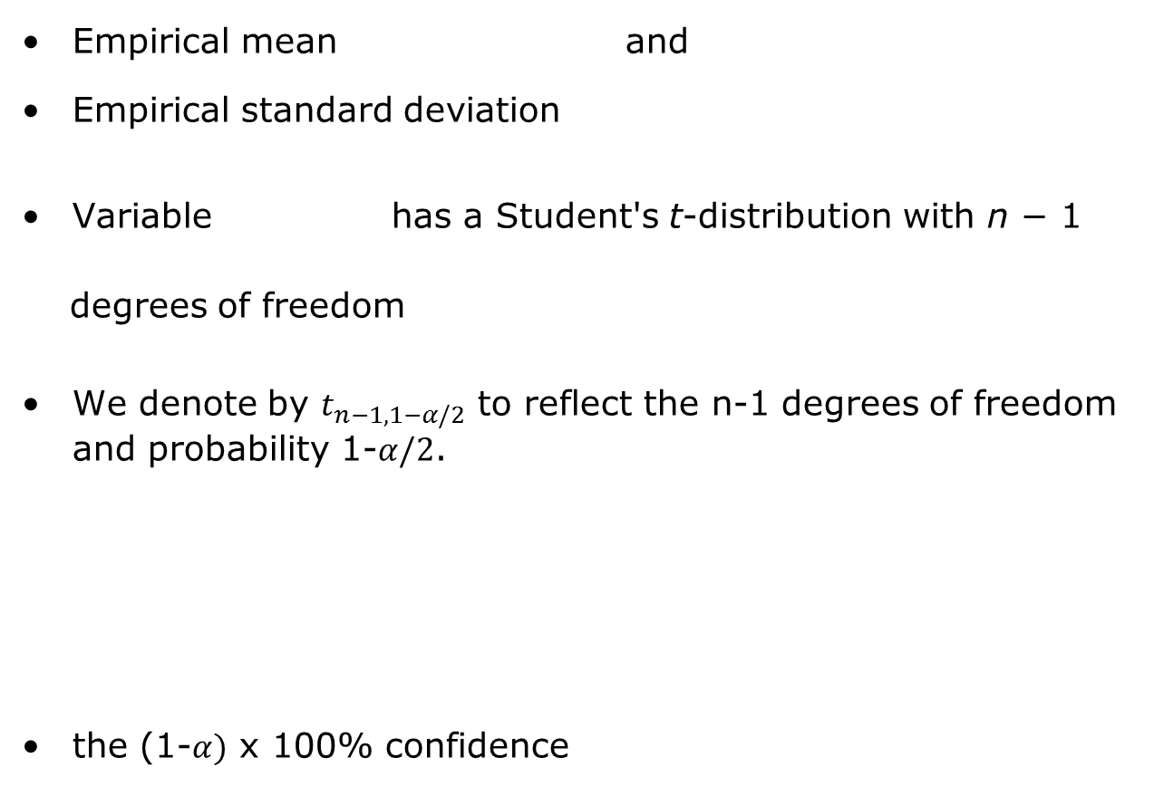
Confidence interval for the mean of Normal distribution with σ unknown
Empirical mean and
Empirical standard deviation
Variable has a Student's t-distribution with n − 1
degrees of freedom
We denote by $t_{n−1,1−α/2}$ to reflect the n-1 degrees of freedom and probability 1-$α/2$.
the (1-$α)$ x 100% confidence
Notes:
If X is sampled from the Normal distribution than
has a standard normal distribution (i.e. normal with expected value 0 and variance 1), and the random variable
{\displaystyle {\frac {{\bar {X}}-\mu }{S/{\sqrt {n}}}}}(where σ has been substituted for S) has a Student's t-distribution with n − 1 degrees of freedom.

Slide 16
Confidence interval for the mean of Normal distribution with σ unknown, cont.
A 95% confidence interval for μ:

Slide 17
Other statistical intervals
Prediction intervals
An intervals that would contain a future randomly selected observation from the distribution, with a specific degree of confidence.
Example: predict sample mean of m future samples
Statistical tolerance limits create an interval that bounds a specified percentage of the population at a given level of confidence.
(such as 99% of the population with 95% confidence)
These intervals are often used to demonstrate compliance with a set of requirements or specification limits.
Notes:
Confidence intervals – analyse the already collected data
Prediction intervals is estimating future estimate (for example, based on consumption of gas from a sample of 5 cars, obtain an interval that contains, with a degree of confidence, the gas consumption of a new car that will operate under specified driving conditions.)
Prediction intervals are useful to predict the performance of one or several of future units. If we would like to estimate performance of large number of units based on a small sample, then instead of computing the confidence interval that contains all of a specified number of units, it is sufficient to construct an interval that contains a large proportion of such units.

Slide 18
Bayesian inference method
Model for data
Likelihood
Data
Bayes theorem
Posterior distribution
Inference
Prior information
By knowing posterior distribution all kinds of estimates can be computed:
Notes:
From “Statistical intervals: Guide for practitioners”

Slide 19
Credible intervals
Interpretation: the probability that the true mean is contained within the given interval is 95%.
Posterior Distribution
95% probability the parameter is here
2.5%
2.5%

Slide 20
Monte Carlo methods
Use
Solving integrals
Propagating uncertainties
Sequential Monte Carlo methods for parameter estimation
Solution
Problem
Estimate
posterior
Integrals are
not tractable
Monte Carlo
Sampling
Difficult to
draw samples
Importance
Sampling

Slide 21
Evaluating integrals using Monte Carlo methods
Example: Estimate the variance of a zero mean Gaussian process
Monte Carlo approach:
Simulate M random variables from a Gaussian distribution
Compute the average

Slide 22
Importance sampling
Classical Monte Carlo integration – Difficult to draw samples from the desired distribution
Importance sampling solution:
Draw samples from another (proposal) distribution
Weight them according to how they fit the original distribution
Free to choose the proposal density
Important:
It should be easy to sample from the proposal density
Proposal density should resemble the original density as closely as possible

Slide 23
Importance sampling
Evaluation of integrals
Monte Carlo approach:
Simulate M random variables from proposal density π(x)
Compute the average

Slide 24
The workflow of Uncertainty Quantification
Step C’: Sensitivity analysis
Step C: Uncertainty propagation
Step A: Definition of the model
Step B: Quantifying sources of uncertainty
- Modeling with probability distributions
Input
Variables
Uncertain: x
Fixed: u
Model
G(x,u)
Variables
of interest
Z=G(x,u)
Quantity of interest
Probability
CI
Measurement data
Step B’: Model calibration, model validation
Test data
Step D: Decision and prediction under uncertainty (in real time)
Notes:
Resources:
Bigoni, Daniele; Engsig-Karup, Allan Peter, Uncertainty Quantification with Applications to Engineering Problems, Technical University of Denmark

Slide 25
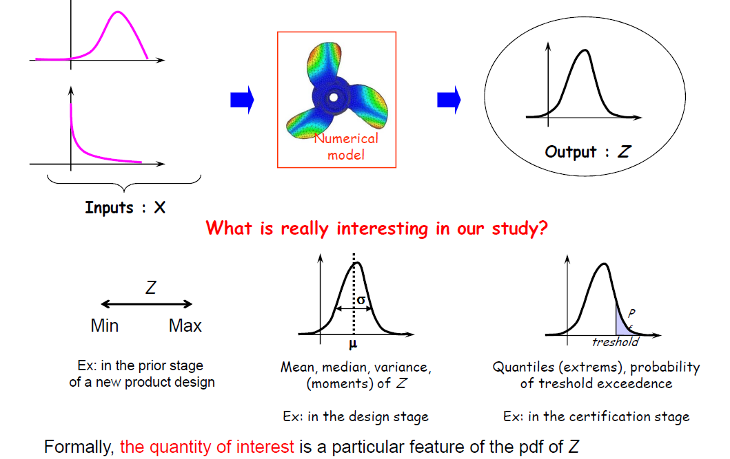
Step A: Focus on the quantity of interest
Notes:
Copied from the slides:
Bertrand Iooss, Treatment of uncertainties in numerical simulation, 29/11/2012

Slide 26
Step B: Quantification of uncertainty sources
A lot of data
Fitting of probability distributions
Statistical hypothesis test
Few data (n < 10)
Hypothesis on parametric probability distribution
Expert judgement, then Bayesian inference
No data
Expert judgment techniques
Taking into account the dependency between inputs is a
crucial issue in uncertainty analysis
Notes:
Copied from the slides:
Bertrand Iooss, Treatment of uncertainties in numerical simulation, 29/11/2012
Correlations can be taken into account in the uncertainty propagation and sensitivity analysis.
Sometimes we can transform correlated into uncerralaterd variables:
For Normal correlated use Cholesky decomposition
For non-normal correlated variables Nataf transformation can be used – it is implemented in Dakota tool.
Karhunen- Luove expansion is the method based on PCA that is commonly used

Slide 27
Step B’: Model Calibration
Model calibration is the process of adjusting unknown model parameters in order to improve the agreement between model output and observed data
Involves “tuning” values of the parameters of the model to best match the observed data
Methods
Maximum likelihood methods
Model is used with fitted parameters to predict future behavior of the system
Bayesian methods for parameter estimation
the predictions allow for all sources of uncertainty, including the remaining uncertainty over the fitted parameters

Slide 28
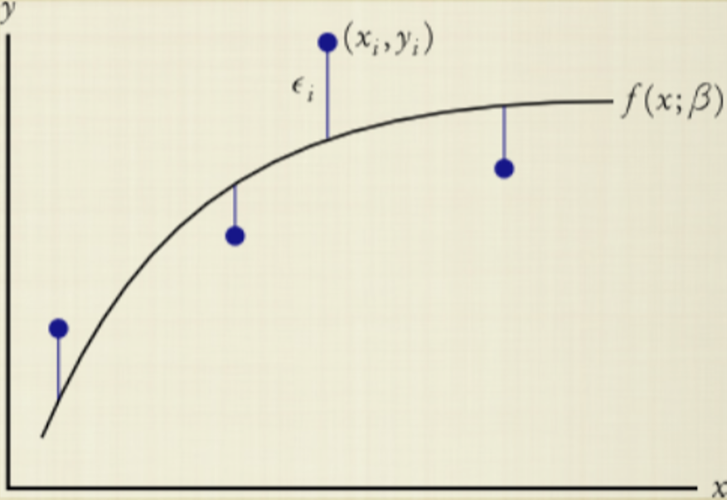
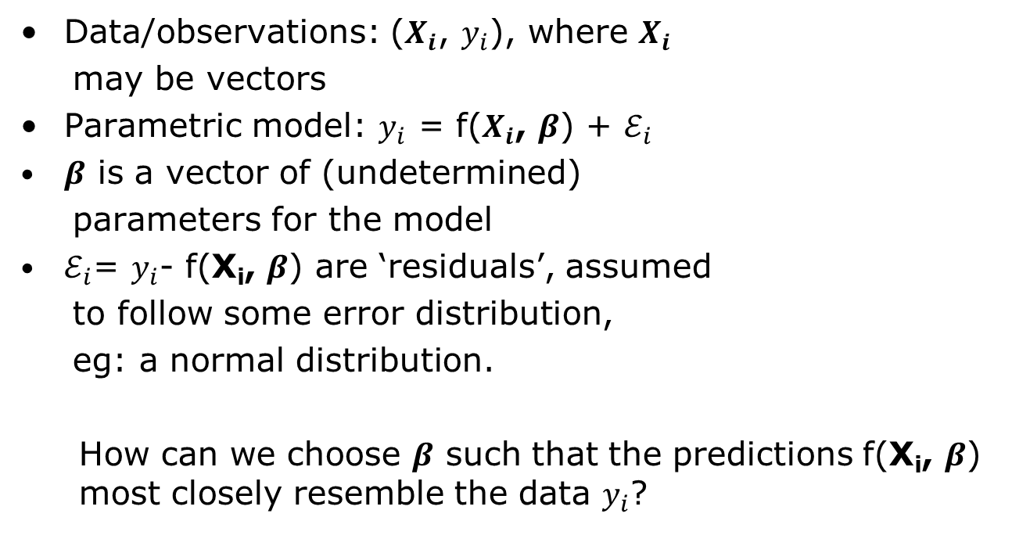
The likelihood of a model
Data/observations: ($X_{i}$, $y_{i}$), where $X_{i}$
may be vectors
Parametric model: $y_{i}$ = f($X_{i}$, $β$) + $ℰ_{i}$
$β$ is a vector of (undetermined)
parameters for the model
$ℰ_{i}$= $y_{i}$- f(X_{i}, $β$) are ‘residuals’, assumed
to follow some error distribution,
eg: a normal distribution.
How can we choose $β$ such that the predictions f(X_{i}, $β$) most closely resemble the data $y_{i}$?

Slide 29
Examples in biomedical engineering
Bioimpedance measurements
Nonlinear fitting to Cole model
Calibration of the blood pressure monitoring devices
SP10

Slide 30
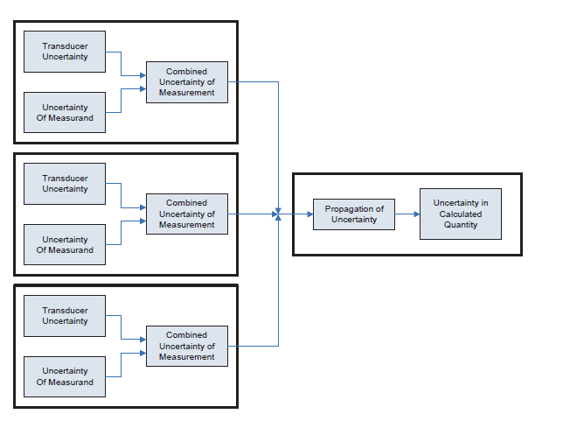
Step C: Propagation of uncertainty

Slide 31
Step C: Methods for propagation of uncertainty
Perturbation methods
the solution is expressed using a suitable Taylor series expansion
Sampling techniques
Monte Carlo based

Slide 32
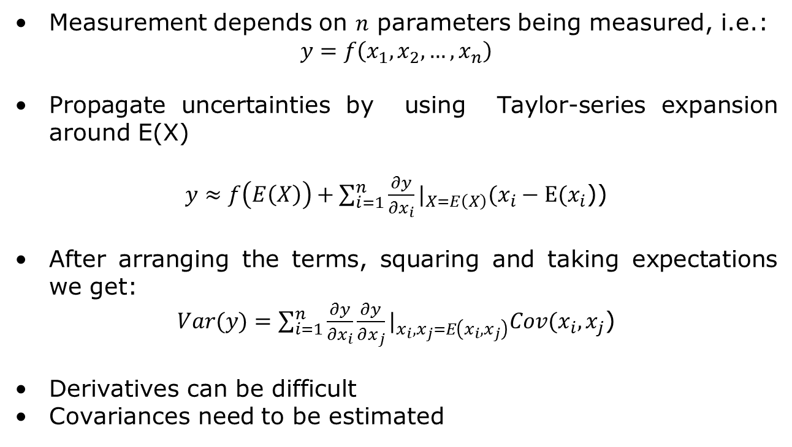
Perturbation methods
Measurement depends on $n$ parameters being measured, i.e.:
$$y=f\left(x_{1},x_{2},…,x_{n}\right)$$
Propagate uncertainties by using Taylor-series expansion around E(X)
$y≈f\left(E\left(X\right)\right)+\sum_{i=1}^{n}{\frac{∂y}{∂x_{i}}}|_{X=E\left(X\right)}(x_{i}−E(x_{i}$))
After arranging the terms, squaring and taking expectations we get:
$Var(y)=\sum_{i=1}^{n}{\frac{∂y}{∂x_{i}}}\frac{∂y}{∂x_{j}}|_{x_{i},x_{j}=E\left(x_{i},x_{j}\right)}Cov(x_{i},x_{j}$)
Derivatives can be difficult
Covariances need to be estimated

Slide 33


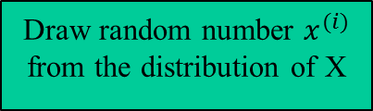
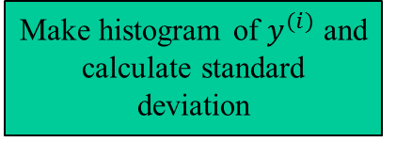


Propagation of uncertainties based on Monte Carlo
Propagate of uncertainties “through” function f
Distribution of measurement errors and input uncertainties has been determined
Works for non-linear models
Disadvantages
Slow convergence
Draw random number $x^{(i)}$ from the distribution of X
$$y=f(x)$$
Compute $y^{(i)}=f\left(x^{\left(i\right)}\right)$
i=M
Make histogram of $y^{(i)}$ and calculate standard deviation
Notes:
Distribution of measurement errors and input uncertainties has been determined – experimentally or using Bayesian methods

Slide 34
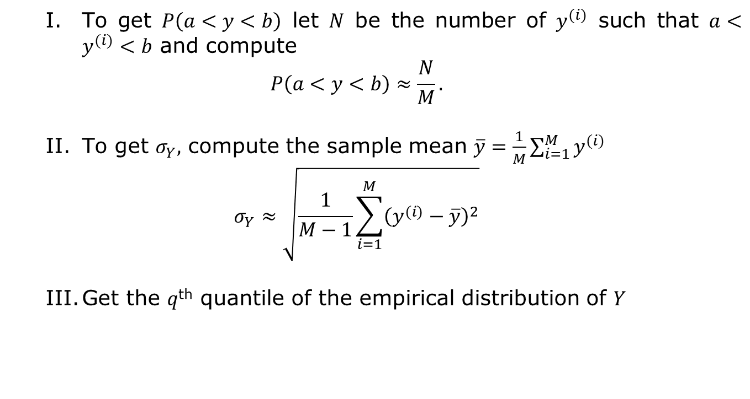
Monte Carlo based propagation of uncertainty
To get $P\left(a<y<b\right)$ let $N$ be the number of $y^{(i)}$ such that $a<y^{(i)}<b$ and compute
$$P\left(a<y<b\right)≈\frac{N}{M}.$$
To get $σ_{Y},$ compute the sample mean $\overline{y}=\frac{1}{M}\sum_{i=1}^{M}{y^{(i)}}$
$$σ_{Y}≈\sqrt{\frac{1}{M−1}\sum_{i=1}^{M}{{\left(y^{(i)}−\overline{y}\right)}^{2}}}$$
Get the $q$^{th} quantile of the empirical distribution of $Y$
Notes:
Analysis of Neural Data

Slide 35
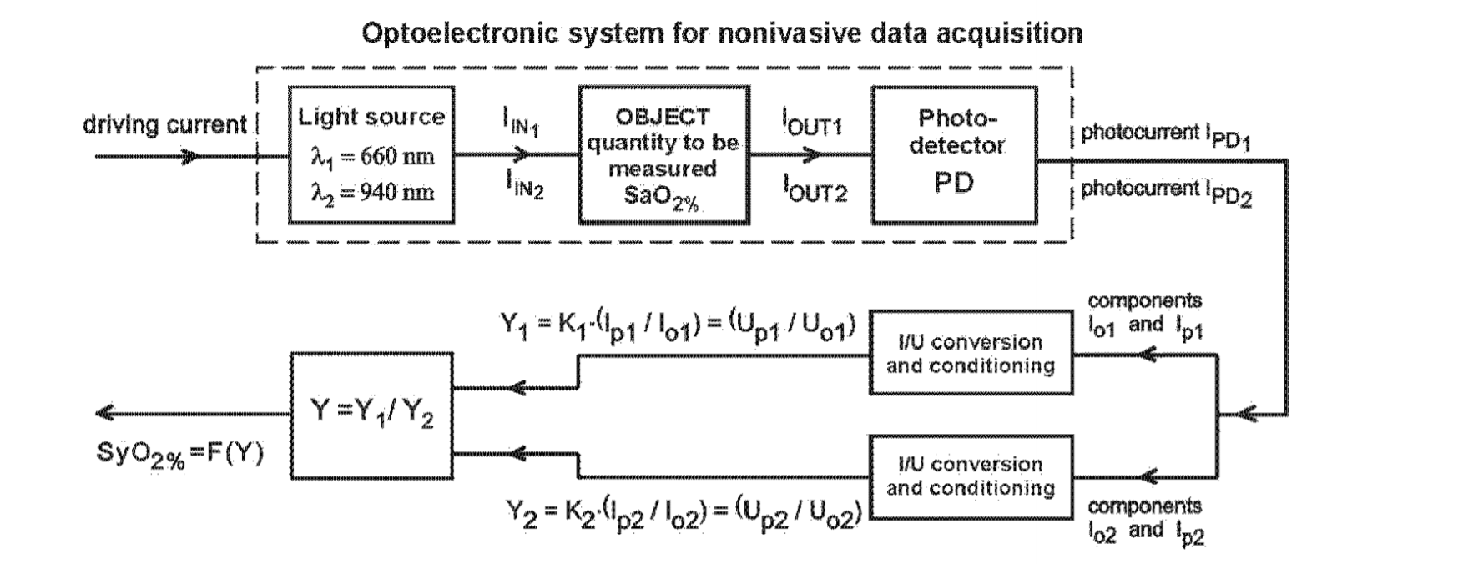
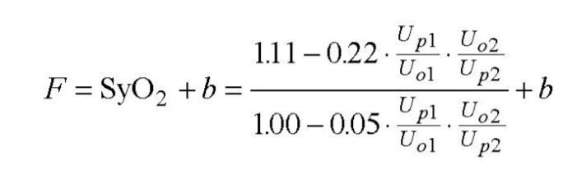
Example - Metrological aspects of pulse oximeter
Notes:
A. Cysewska-Sobusiak, "Estimation of Uncertainty in Complex Biomeasurements," 2007 IEEE International Workshop on Advanced Methods for Uncertainty Estimation in Measurement, Sardagna, 2007, pp. 24-29.

Slide 36
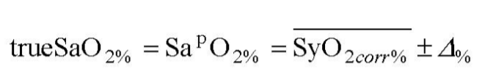
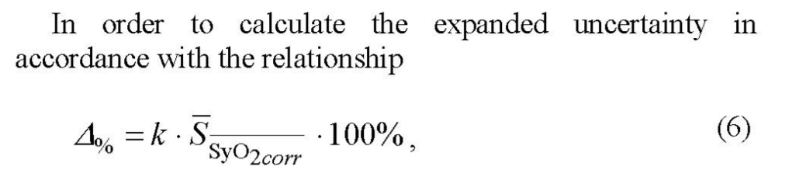


Slide 37
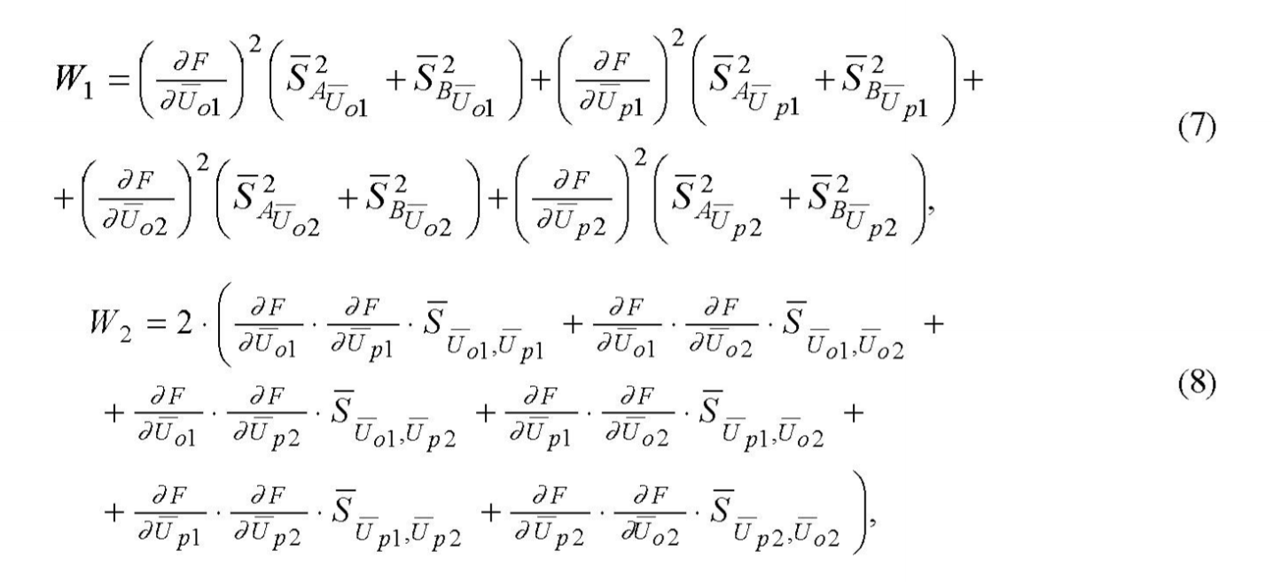

Slide 38
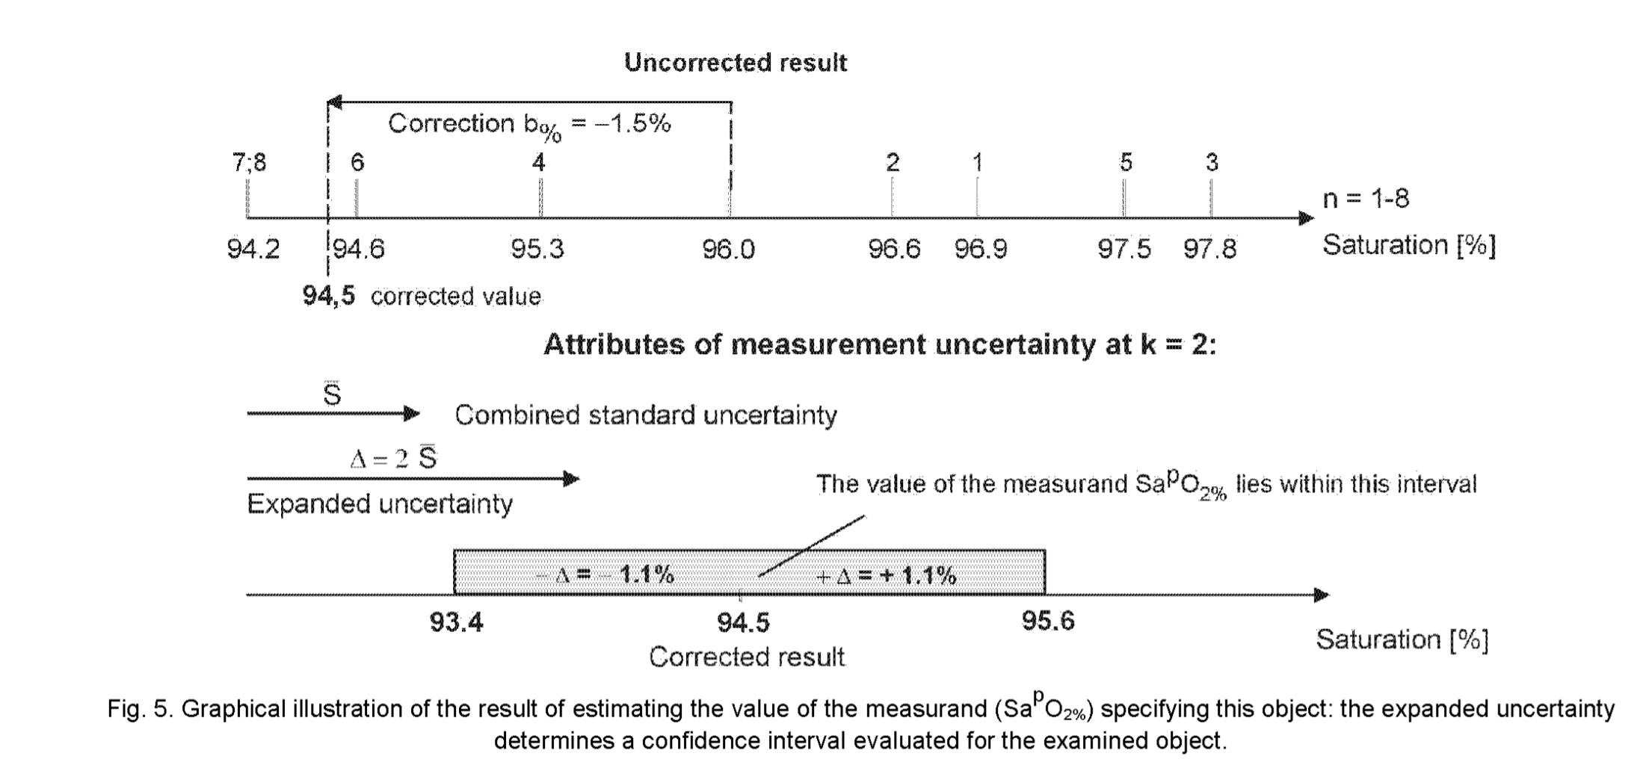

Slide 39
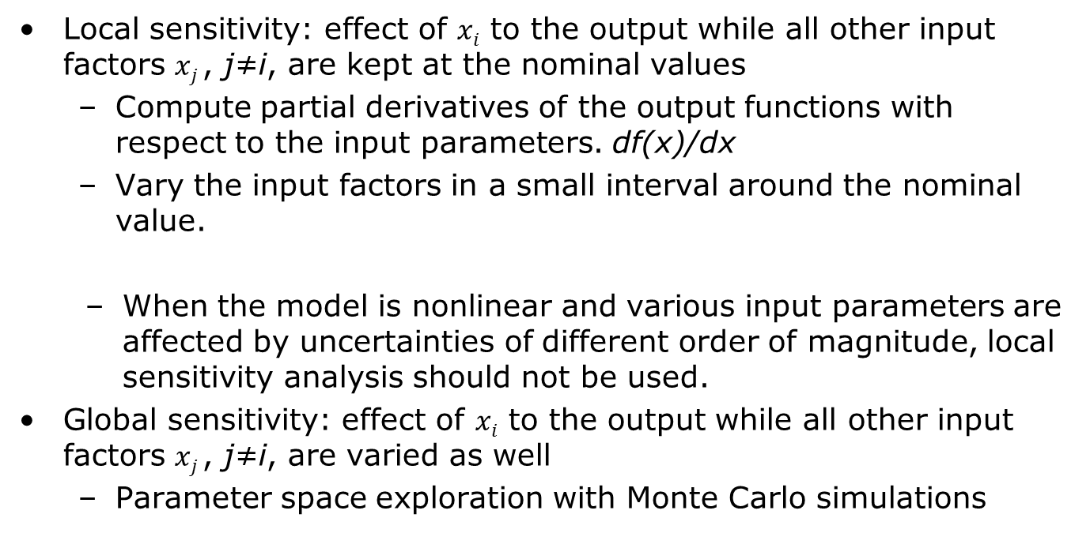
Step C’: Sensitivity analysis
Local sensitivity: effect of $xi$ to the output while all other input factors $xj$, j≠i, are kept at the nominal values
Compute partial derivatives of the output functions with respect to the input parameters. df(x)/dx
Vary the input factors in a small interval around the nominal value.
When the model is nonlinear and various input parameters are affected by uncertainties of different order of magnitude, local sensitivity analysis should not be used.
Global sensitivity: effect of $xi$ to the output while all other input factors $xj$, j≠i, are varied as well
Parameter space exploration with Monte Carlo simulations
Notes:
Morris Elementary Effects
Perform local sensitivity on the grid and definesensitivity metrics
Sobol indices
Variance based decomposition method

Slide 40
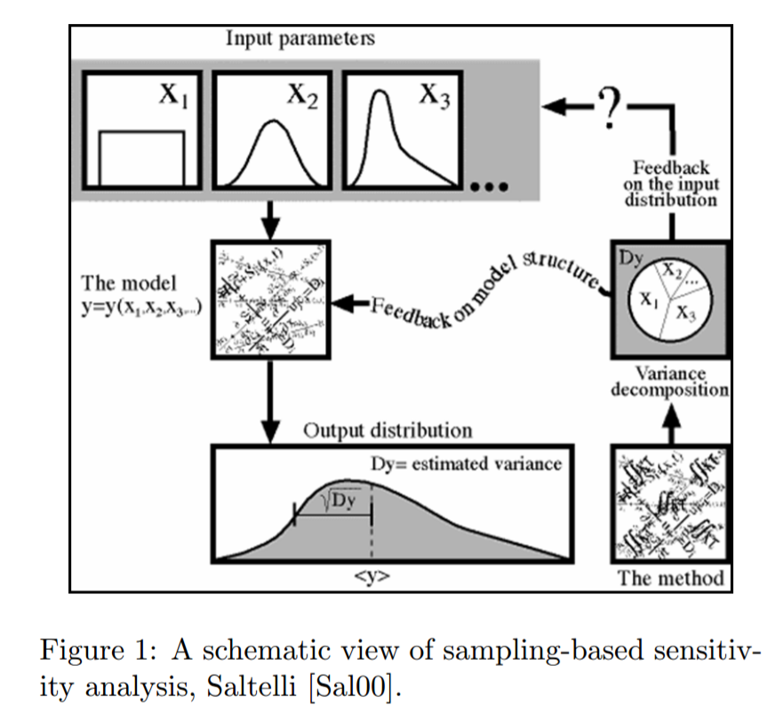
Step C’: Sensitivity analysis
Most important parameters in your model?
Reduce the dimension of the model by fixing unimportant parameters

Slide 41
Pertubation Sensitivity Analysis
‘Perturb’ assesses the impact of small random changes to variables on parameter estimates. If small amounts of noise do not alter the estimated coefficients, we say that the output is less sensitive to them.
Specify the data, model, and model options
Introduce small random perturbations to the data
Recalculate the estimate using the perturbed data
Examine the sensitivity of the parameter estimates
When the estimates produced using this technique very greatly, the model estimation is necessarily unstable.

Slide 42
Sensitivity analysis with Monte Carlo simulations
Generate samples from a parameter space
Which distribution we chose?
Is every parameter combination equally meaningful?
Pass the parameters to the model
Measure association between the result and each parameters
Matlab sensitivity toolbox

Slide 43
Example Sensitivity Analysis
Mathematical model of the artery, tissue and the cuff
It also include personal parameters such as age, weight and so on
Sensitivity analysis to determine most sensitive parameters of the model
Derive compensation function that include estimation using fixed parameters such as regular BP device and then compensation based on linear regression.
Notes:
C:\Users\Bolic\Dropbox\Backup\doc\data quality paper\James_Matthew_20130114_Phd

Slide 44
Conclusion
Some interesting approaches
Uncertainty in the cloud
Uncertainty in biomedical instrumentation and signals processing
Resources
Courses
Books
References

Slide 45
Self-validating (SEVA) sensors
Sensors that provide uncertainty info with the data
Device status
Transducer
Processor + Transmitter
Sensed value
Confidence intervals
Detailed diagnostic
Notes:
Uncertainty in Deep Learning
http://mlg.eng.cam.ac.uk/yarin/blog_2248.html

Slide 46
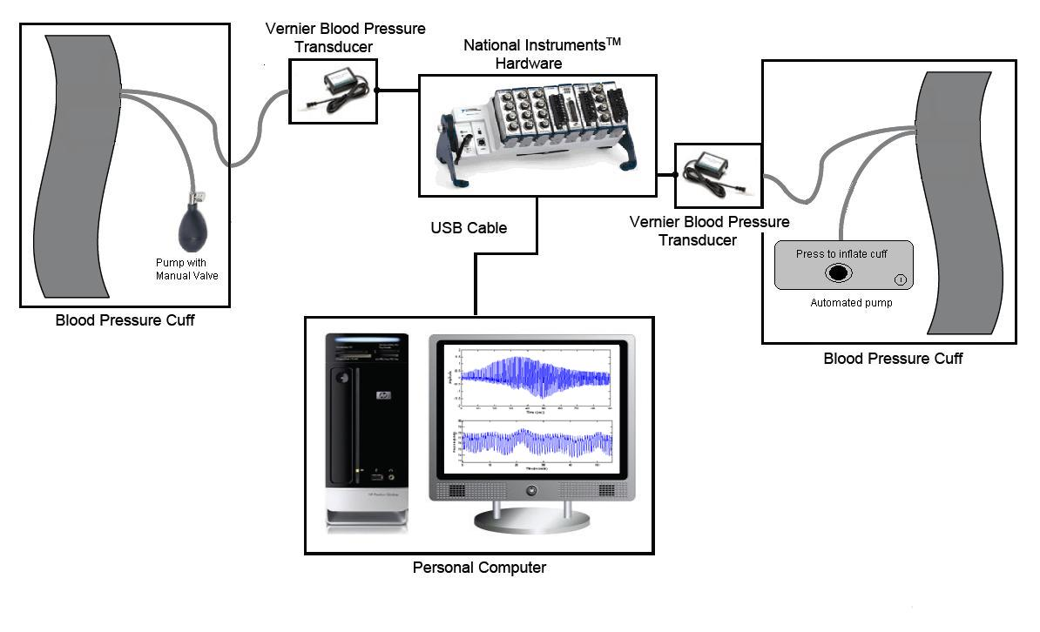
Confidence intervals for blood pressure estimation
Idea – obtain empirical probability distribution based on the data from another arm measured at constant pressure
Calibrate the empirical distribution with calculated diastolic and systolic measurements
Notes:
Karen Soueidan, Augmented Blood Pressure Measurement through the Estimation of Physiological Blood Pressure Variability, University of Ottawa, Master thesis, December 3rd, 2010.

Slide 47
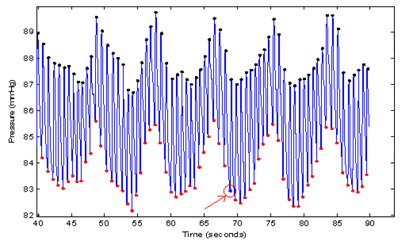
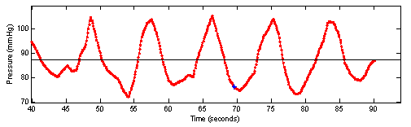
Augmented blood pressure measurement
Mean DBP = 87.3 mmHg
Standard deviation (σ) = 7.8 mmHg
Difference (OMW-INT_MEAN) = 10.76 mmHg (within 2σ margin,
not an outlier)
Notes:
1-Provide SBP and DBP readings that are more representative of the variable blood pressure levels than those taken at random instances of time
2-Provide a measure of the variability of the readings
3-Determine whether a given reading is unusually high or low, which could be used to issue an alert (repeat the measurement)
Not artifactual
Might be misrepresentative of the average BP over time
But accurately reflecting the BP at that time
High physiological variability
Karen Soueidan, Augmented Blood Pressure Measurement through the Estimation of Physiological Blood Pressure Variability, University of Ottawa, Master thesis, December 3rd, 2010

Slide 48
Uncertainty in the cloud
Goal:
Making sense in real-time of multiple, heterogenous, noisy and possibly incomplete data streams in order to support the decision process of very large number of concurrent users.
Combination of stream or complex event processing and uncertainty
Using Bayesian networks for uncertainty quantification and propagation
Current research is done on smart-homes but on very simple examples

Slide 49
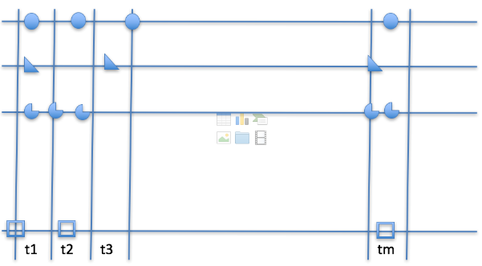
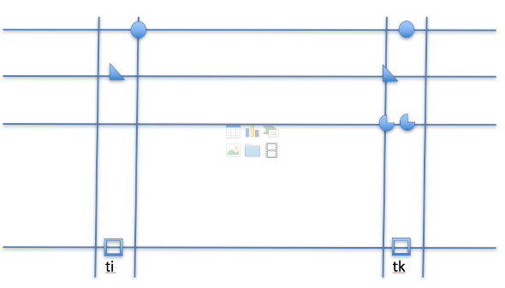
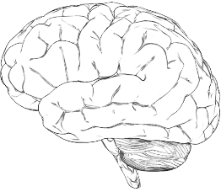

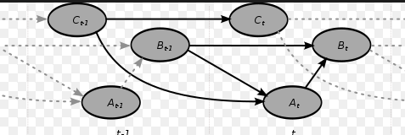
Uncertainty as a Service workflow
CEP Initiator
CEP rules in #m time intervals
Reduce stream size to #n
Where n << m
Map<EventType, DistribtuionEvent>
Each Event is extended with its distribution. Distribution can be continuous or discrete values
Map<EventType, List<Events>>
in time #m intervals
Probabilistic Initiator
Based on input data (additional data?)
Available time to produce result
Processing power
Notes:
From Mira Vrbaski, University of Ottawa

Slide 50

Message
Biomedical instrumentation and signal processing community needs start using uncertainty evaluation as a standard tool in our processing toolbox.
Notes:
https://www.google.ca/url?sa=i&rct=j&q=&esrc=s&source=images&cd=&ved=0ahUKEwiP_82r9cfTAhVmiVQKHc4aAOYQjRwIBw&url=http%3A%2F%2Ftoolguyd.com%2Fquickdraw-self-marking-tape-measure%2F&psig=AFQjCNEtP3fciJsccYLYn0hBEAWeuoOaRw&ust=1493495188933485

Slide 51
Uncertainty related resources - Tools
SimLab
https://ec.europa.eu/jrc/en/samo/simlab
OpenTurns
http://www.openturns.org/
C++ with Python wrappers
UQLab
http://www.uqlab.com/
Matlab
MIT Uncertainty Quantification Library (MUQ)
C++
…

Slide 52
Uncertainty related resources - Courses
With Videos
Uncertainty Quantification in Engineering Science
http://eclass.uth.gr/eclass/courses/MHXB124/
Introduction to Uncertainty Quantification
https://www.ima.umn.edu/2014-2015/ND6.15-26.15/#
Without videos
MA 540 Uncertainty Quantification for Physical and Biological Models
http://www4.ncsu.edu/~rsmith/MA540_s17.html

Slide 53
Uncertainty related resources - Books
F. Pavese, A. B. Forbes, Data Modeling for Metrology and Testing in Measurement Science, Springer, 2009.
S. V. Gupta, Measurement Uncertainties, Physical Parameters and Calibration of Instruments, Springer-Verlag Berlin Heidelberg 2012.
I. Lira, Evaluating the Measurement Uncertainty: Fundamentals and Practical Guidance, IoP 2002.
H. W. Coleman, W. G. Steele, Experimentation, validation and uncertainty analysis for Engineers, Wiley, 2009.
A. Zoubir, D. R. Iskander, Bootstrap techniques for signal processing, Cambridge University Press, 2004.
W. Q. Meeker, G. J. Hahn, L. A. Escobar, Statistical Intervals: A Guide for Practitioners and Researchers, 2nd Edition, Wiley, 2017.
R. C. Smith, Uncertainty Classification: Theory, Implementation and Applications, SIAM, 2014.
K. Beven, Environmental Modelling: An Uncertain Future?, Taylor & Francis e-Library, 2010.

Slide 54
References
C:\Users\Bolic\Dropbox\Backup\doc\data quality paper\Mahadevan_SDI_July2011-1-.pdf
Surrogate: C:\Users\Bolic\Dropbox\Backup\doc\data quality paper\16_A3_BSP_Xspec_Lecture
Silvelyn Zwanzig and Behrang Mahjani, “Computer intensive methodsin statistics”
From: William F. Guthrie,1 Hung-kung Liu,2 Andrew L. Rukhin,3 Blaza Toman, Jack C. M. Wang,5 Nien fan Zhang, Three Statistical Paradigms for the Assessment and Interpretation of Measurement Uncertainty, from Data Modeling for Metrology and Testing in Measurement Science by Franco Pavese and Alistair B. Forbes
BIPM, IEC, IFCC, ISO, IUPAC, IUPAP, and OIML. Guide to the expression of uncertainty in
measurement, International Organization for Standardization. GUM 1995 with minor corrections. Corrected version 2010. JCGM 100:2008.
BIPM, IEC, IFCC, ISO, IUPAC, IUPAP, and OIML. Evaluation of measurement data — Supplement 1 to the Guide to the expression of uncertainty in measurement — Propagation of distributions using a Monte Carlo method. JCGM 101:2008.

